Slide 1
CH107: Physical Chemistry
Quantum Mechanics in Chemistry:
Hydrogen atom: orbitals
Multielectron atoms: Spin orbital
Molecules: Molecular orbitals
Molecular Spectroscopy: Rotation, vibration, Raman
Instructor:
Anindya Datta
Room 206
1st floor, Chemistry
Phone: 25767149; 9769257149
Email: adutta@iitb.ac.in
Course Secretary:
Sangeeta Prasad
Central Facility,
2nd floor, Chemistry Annexe
Phone: 25764159
Email: sangeeta@chem.iitb.ac.in
Facebook group: CH 107 D2 2016

Slide 2
Tutorial venue and Teaching Assistants
CH 107: Division 2
D2/T1 LT-304 Anindya Datta
D2/T2 LT-305 Nikita Chiripal
D2/T3 LT-306 Kaushik Talukdar
D2/T4 LT-205 Anasuya Mukhopadhyay
D2/T5 LT-206 Abhishek Singh
Emails and phone numbers to be provided
Help sessions: Please send an email and schedule an appointment

Slide 3
CH 107 schedule and evaluation scheme
Duration Half-semester (~8 weeks)
Quiz 15 October 2016
End-Semester Exam to be declared
Evaluation Scheme
Mini quiz during tutorials 8 marks
Quiz 3×6 marks = 18 marks
End-Semester Exam 4×6 marks = 24 marks
Passing Marks ?

Slide 4
CH 107: Grading Statistics
2015
2014
2013
AA 130
AB 175
AP 13
BB 171
BC 159
CC 121
CD 75
DD 33
FR 36
II 4
Total 917
AA 62
AB 137
AP 8
BB 154
BC 134
CC 118
CD 91
DD 81
FR 77
II 31
Total 893
AA 34
AB 88
AP 3
BB 116
BC 123
CC 133
CD 126
DD 112
FR 140
Total 875

Slide 5







CH 107: Philosophy
Don’t worship false gods (grades, CPI etc.)
Worship the true God (understanding)
Credits:
Professors
G. Naresh Patwari
Y. U. Sasidhar
B.. L. Tembe
Ruchi Anand
Rajarshi Chakrabarti
Sandip Kar
Arindam Chowdhury

Slide 6
Why we study CH 107
CH-107
Apply laws of quantum physics
to understand the behavior
of atoms and molecules
PH-107
CH-105
Microscopic entities
behave differently
/ laws of quantum physics
Deeper understanding
of physical processes
Collective behavior of
atoms and molecules
Bridge between novel molecules (materials) prepared by synthetic chemists and their potential applications, (often dealt with by engineers)
Nanoelectronics/Nanotechnology: Molecular Electronics
Energy Science: “Solar Energy” conversion
Biotechnology: Disease cure, health, medicine
Atmospheric Science: Go Green - “Save the World”

Slide 7


Why we study CH 107
Quantum theory is necessary for the understanding and the development of processes and devices at a molecular level
A scientist/ engineer must never be a frog in the well
history.cultural-china.com
vkaisthaaseem.blogspot.com

Slide 8
CH 107: Flowchart
PH-107
Fundamentals of
Quantum Physics
applied
to the
CH-107
Hydrogen
Atom
Yields
three
Quantum
numbers
Schrodinger
Equation
Multi-electron Atoms
(Periodic Table)
Tunneling
Processes
Particle
In a Box
Harmonic
oscillator
Atomic/Molecular
Spectroscopy
Multi-atomic
Bonding, Molecular
Structure
Band theory
Barrier
Penetration
Chemical Reactions
Molecular Dynamics
Intermolecular Forces
And Interactions
Biology,
Materials Science
Condensed Matter
Physics

Slide 9
CH 107: Text books
Physical Chemistry – I.N. Levine, 5th Ed.
Physical Chemistry – P.W. Atkins 2nd Ed.
Physical Chemistry: Molecular Approach - McQuarrie and Simon
Fundamentals of molecular spectroscopy – Banwell and McCash
Important Websites:
CH107 Course Material for 2013 and previous year’s power-point slides:
www.chem.iitb.ac.in/academics/menu.php
http://vod.cdeep.iitb.ac.in/ (Previous years lectures)
All materials will be uploaded on IITB Moodle
http://moodle.iitb.ac.in

Slide 10
PH107: Recapitulation

Slide 11
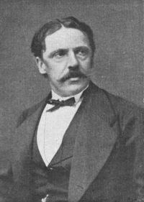
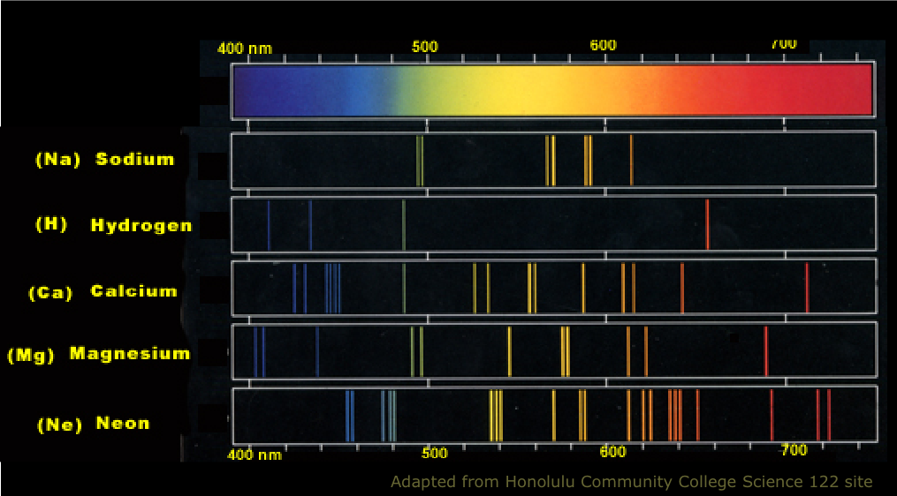
Atomic Spectra
Balmer Series
410.1 nm
434.0 nm
486.1 nm
656.2 nm
The Rydberg-Ritz Combination Principle states that the spectral lines of any element include frequencies that are either the sum or the difference of the frequencies of two other lines.
“R∞ is the most accurately measured fundamental physical constant”

Slide 12
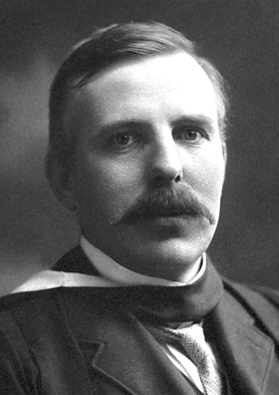
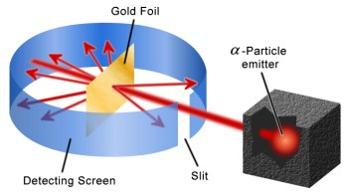
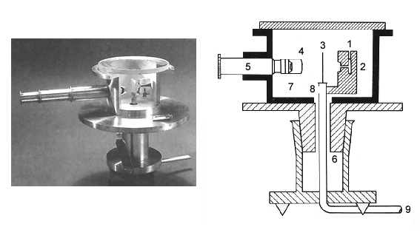
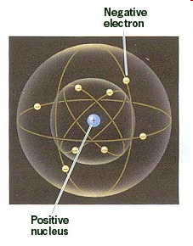
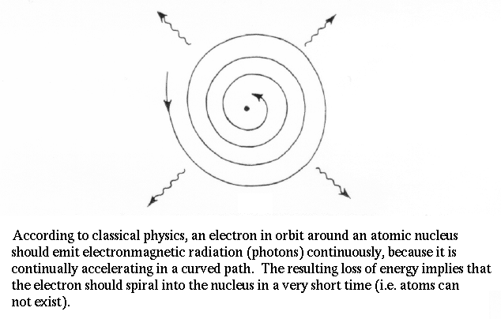
Rutherford Model of Atom
Planetary model of atoms with central positively charged nucleus and electrons going around
Classical electrodynamics predicts that such an arrangement emits radiation continuously and is unstable

Slide 13
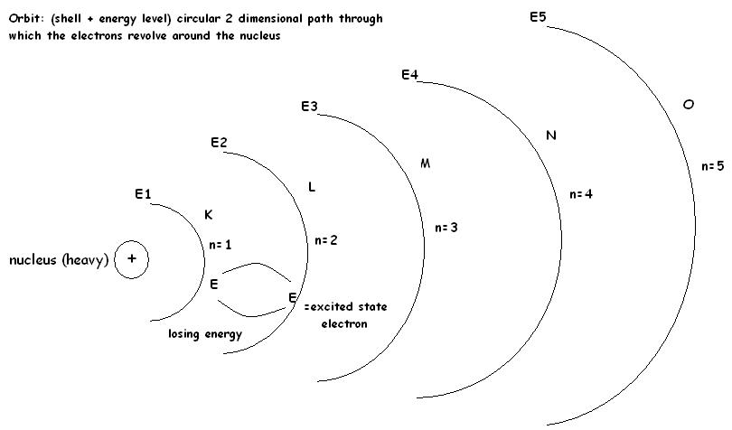
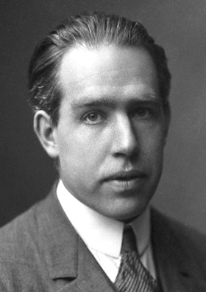
Bohr Phenomenological Model of Atom
Electrons rotate in circular orbits around a central (massive) nucleus, and obeys the laws of classical mechanics.
Allowed orbits are those for which the electron’s angular momentum equals an integral multiple of h/2π i.e. m_{e}vr = nh/2π
Energy of H-atom can only take certain discrete values: “Stationary States”
The Atom in a stationary state does not emit electromagnetic radiation
When an atom makes a transition from one stationary state of energy E_{a} to another of energy E_{b}, it emits or absorbs a photon of light: E_{a} – E_{b} = hv

Slide 14
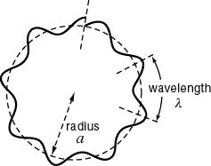
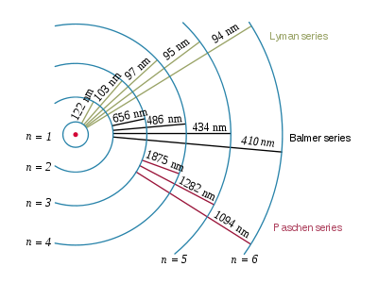
Bohr Model of Atom
Angular momentum quantized
Energy expression
Spectral lines
Explains Rydberg formula
Ionization potential of H atom 13.6 eV

Slide 15
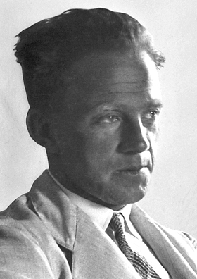
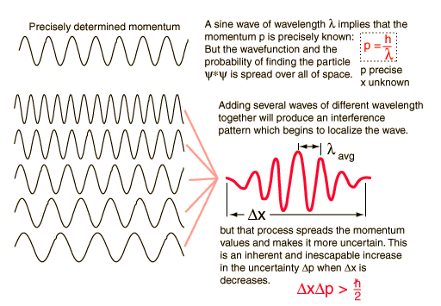
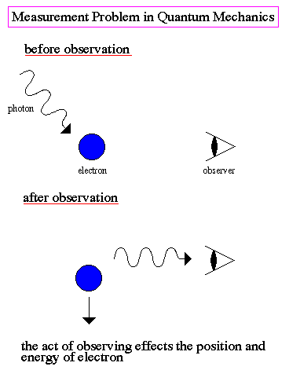
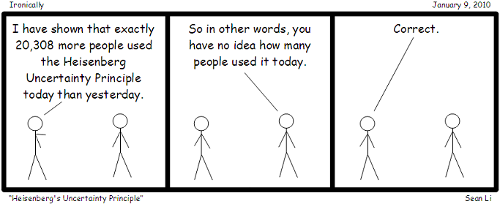

Uncertainty Principle
Uncertainty principle

Slide 16
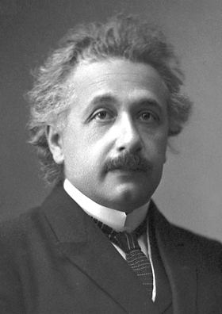
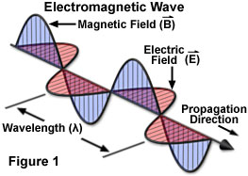
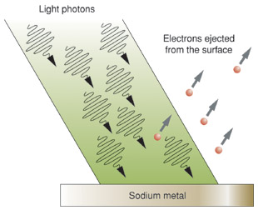
Photoelectric Effect: Wave –Particle Duality
Electromagnetic Radiation
Wave energy is related to Intensity
I ∝ E²₀ and is independent of ω
Einstein borrowed Planck’s idea that ΔE=hν and proposed that radiation itself existed as small packets of energy (Quanta)now known as PHOTONS
φ = Energy required to remove electron from surface

Slide 17
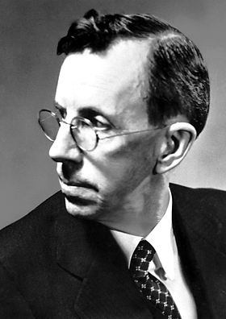
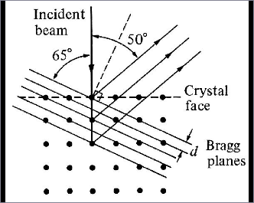
Diffraction of Electrons : Wave –Particle Duality
Davisson-Germer Experiment
A beam of electrons is directed onto the surface of a nickel crystal. Electrons are scattered, and are detected by means of a detector that can be rotated through an angle θ. When the Bragg condition
mλ = 2dsinθ was satisfied (d is the distance between the nickel atom, and m an integer) constructive interference produces peaks of high intensity

Slide 18
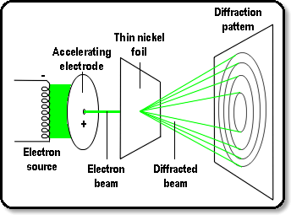
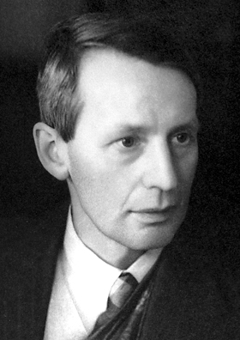
Diffraction of Electrons : Wave –Particle Duality
G. P. Thomson Experiment
Electrons from an electron source were accelerated towards a positive electrode into which was drilled a small hole. The resulting narrow beam of electrons was directed towards a thin film of nickel. The lattice of nickel atoms acted as a diffraction grating, producing a typical diffraction pattern on a screen

Slide 19
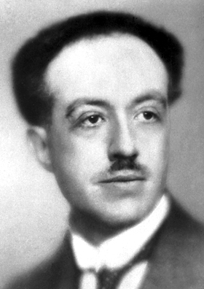
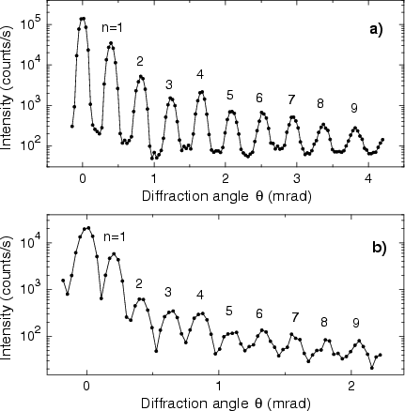
de Broglie Hypothesis: Mater waves
Since Nature likes symmetry,
Particles also should have wave-like nature
De Broglie wavelength
Electron moving @ 10⁶ m/s
He-atom scattering
Diffraction pattern of He atoms at the speed 2347 m s⁻¹ on a silicon nitride transmission grating with 1000 lines per millimeter. Calculated de Broglie wavelength 42.5x10⁻¹² m
de Broglie wavelength too small for macroscopic objects

Slide 20
Diffraction of Electrons : Wave –Particle Duality
The wavelength of the electrons was calculated, and found to be in close agreement with that expected from the De Broglie equation

Slide 21
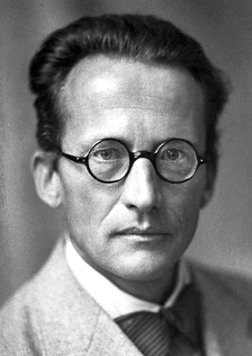
Schrodinger’s philosophy
PARTICLES can be WAVES
and WAVES can be PARTICLES
New theory is required to explain the behavior of electrons, atoms and molecules
Should be Probabilistic, not deterministic
(non-Newtonian) in nature
Wavelike equation for describing sub/atomic systems

Slide 22

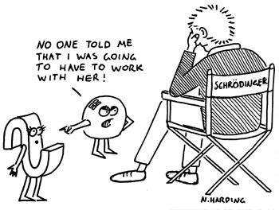
Schrodinger’s philosophy
PARTICLES can be WAVES
and WAVES can be PARTICLES
let me start with
classical wave equation
A concoction of

Slide 23

Schrodinger’s philosophy
Remember!

Slide 24
Schrodinger Equation
Time-dependent Schrodinger equation
Schrodinger equation in 3-dimensions

Slide 25
Schrodinger Equation
Time-dependent Schrodinger equation

Slide 26
Schrodinger Equation
LHS is a function of co-ordinates and RHS is function of time. If these two have to be equal then both functions must be equal to constant, say W

Slide 27
Schrodinger Equation
Separation of variables
The solution of the differential equation

Slide 28
Schrodinger Equation
In classical mechanics Ĥ represents total energy
We can therefore write
Schrodinger equation is an eigenvalue equation
There can be many solutions ψ_{n}(x) each corresponding to different energy E_{n}

Slide 29
Laws of Quantum Mechanics
The mathematical description of Quantum mechanics is built upon the concept of an operator
Classical Variable
QM Operator

Slide 30
Laws of Quantum Mechanics
The values which come up as result of an experiment are the eigenvalues of the appropriate operator
In any measurement of observable associated with operator Â, the only values that will be ever observed are the eigenvalues an, which satisfy the eigenvalue equation:
Ψ_{n} are the eigenfunctions of the system and a_{n} are corresponding eigenvalues
If the system is in state Ψ_{k} , a measurement on the system will yield an eigenvalue a_{k}

Slide 31
Laws of Quantum Mechanics
Only real eigenvalues will be observed, which will specify a number corresponding to the classical variable
There may be, and typically are, many eigenfunctions for the same QM operator!

Slide 32
Laws of Quantum Mechanics
All the eigenfunctions of Quantum Mechanical operators are “Orthogonal”

Slide 33
Laws of Quantum Mechanics
The average value of the observable corresponding to operator Â is
From classical correspondence we can define average values for a distribution function P(x)
<a> corresponds to the average value of a classical physical quantity or observable , and Â represents the corresponding Quantum mechanical operator

Slide 34
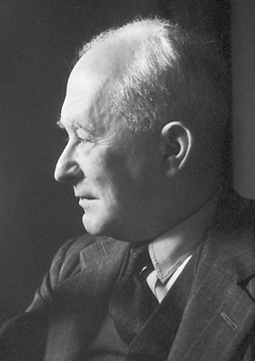
Born Interpretation
Classical wave equation:
Ψ(x,t) = Amplitude and |Ψ(x,t)|² = Intensity
Quantum mechanical system:
The state is completely specified by a wavefunction Ψ(x,t) ,which can be complex
All possible information can be derived from Ψ(x,t)
Intensity is equivalent to Probability.
|Ψ(x,t)|² = P(x)

Slide 35
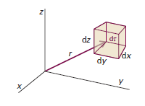
Born Interpretation
Probability density
Probability
Probability in 3-dimensions

Slide 36
Normalization of Wavefunction
Since Ψ*Ψdτ is the probability, the total probability of finding the particle somewhere in space has to be unity
If function diverges, i.e.  ∞: Ψ can not be normalized, and therefore is NOT an acceptable wave function. However, a constant value C ≠ 1 is perfectly acceptable.
Ψ
∞
∞
x 
∞
∞
Ψ
x 
Unacceptable wavefunction
Ψ must vanish at ±∞, or more appropriately at the boundaries and Ψ must be finite

Slide 37
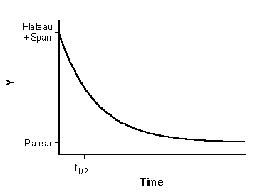
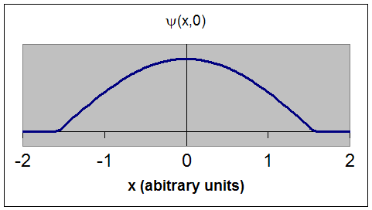
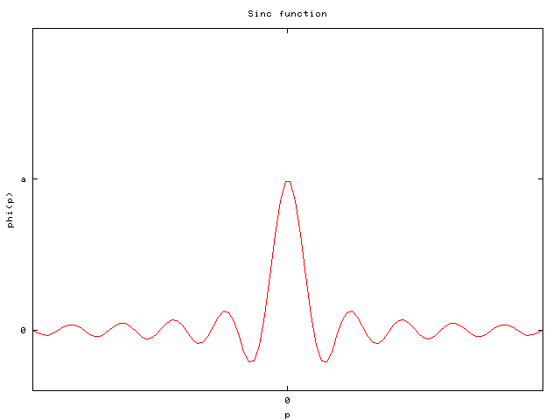
Acceptable wavefunctions

Slide 38
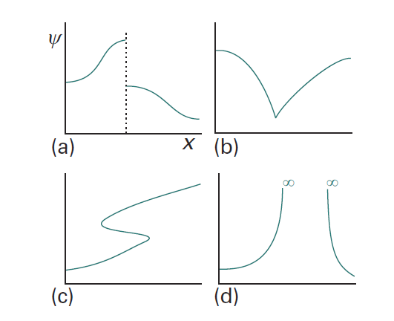
Restrictions on wavefunction
Unacceptable because ψ is not continuous
Unacceptable because dψ/dq is not continuous
Unacceptable because ψ is not single-valued
Unacceptable because ψ goes to infinity

Slide 39
Restrictions on wavefunction
ψ must be a solution of the Schrodinger equation
ψ must be normalizable: ψ must be finite and 0 at boundaries/ ±∞
Ψ must be a continuous function of x,y,z
dΨ/dq must be must be continuous in q
Ψ must be single-valued
Ψ must be quadratically-intergrable
(square of the wavefunction should be integrable)
Origin of quantization

Slide 40
Essence of Quantum Mechanics
Not deterministic: Can not precisely determine many parameters in the system, but Ψ can provide all the information (spatio-temporal) of a system.
Only average values and probabilities can be obtained for classical variables, now in new form of “operators”.
Total energy is conserved, but quantization of energy levels come spontaneously from restriction on wave function or boundary condition
Final outputs tally very well with experimental results, and does not violate Classical mechanics for large value of mass.

Slide 41
Quantum Mechanics
Examples of Exactly Solvable Systems
Free Particle
Particle in a Square-Well Potential
Hydrogen Atom

